Slide 1
Using Data to Combat the Opioid Overdose Crisis

Slide 2
Using Data to Drive Decisions
Why Data?
Removes values and beliefs from the information available to make decisions
Eliminates terminology gaps between public safety and public health
Removes “he said/she said” from projects
Considerations
Collection and standardization of process
Timeliness of analysis and dissemination
Effective public health and public safety collaboration
Translation of data to information and strategy

Slide 3
Using Data to Drive Decisions
Data in the TAC Process
Assessment
  Define the problem
Capacity
  Stakeholder alignment and community activation
Planning
  Determination of what strategies will be most effective to eliminate the problem
Implementation/Evaluation
  Quality improvement
  Overall success/failure of the program
Sustainability
  Obtaining grant funding (moving to next phase/temporary)
  Building local, state, national support around the strategy
  Facilitating third party payment strategies

Slide 4
Data Examples
Overdose Death Data
What might this information tell us?
Deaths in age groups do not match what is seen at the state level.
Older individuals may be dying from different substances (e.g. alcohol).
Education efforts need to be tailored to specific age groups.
Age and Gender Distribution of Overdose Deaths in 2016

Slide 5
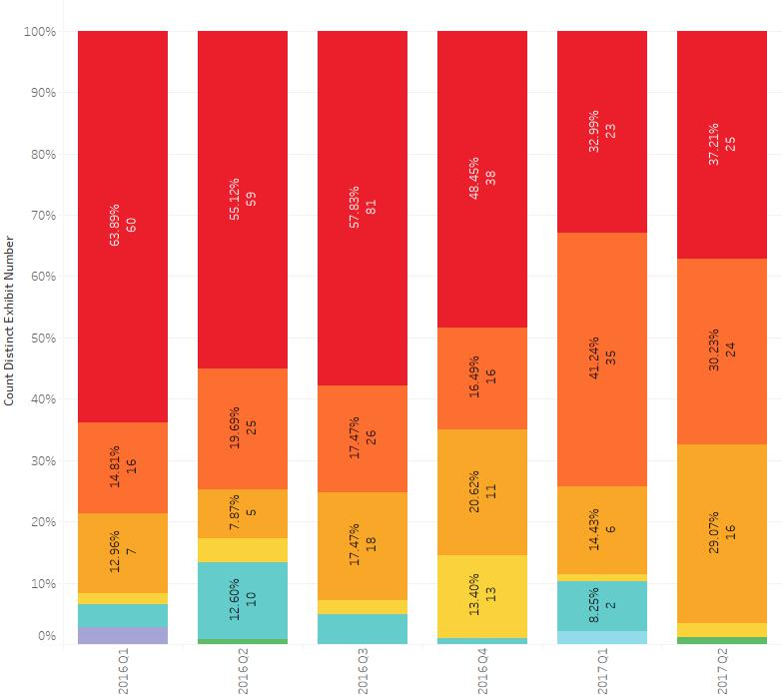
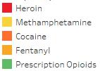
Data Examples
NFLIS Data
What can be learned from this data?
Drugs Seized by Quarter
(2016-Q2 2017)
What substances are in the drug supply.
When compared with overdose death data, can tell us if what is in the supply is being seen in deaths.
Law enforcement can identify emerging threats and know what to look for.
Data can also be used to understand what individual’s are prioritizing.

Slide 6
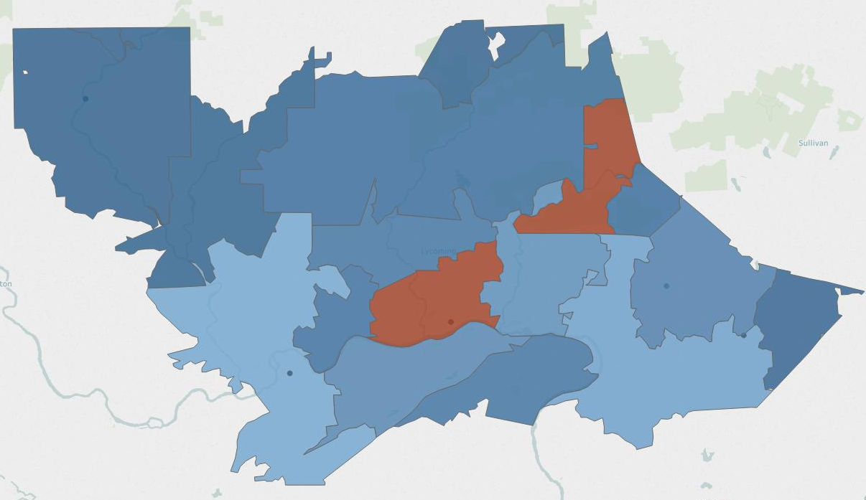
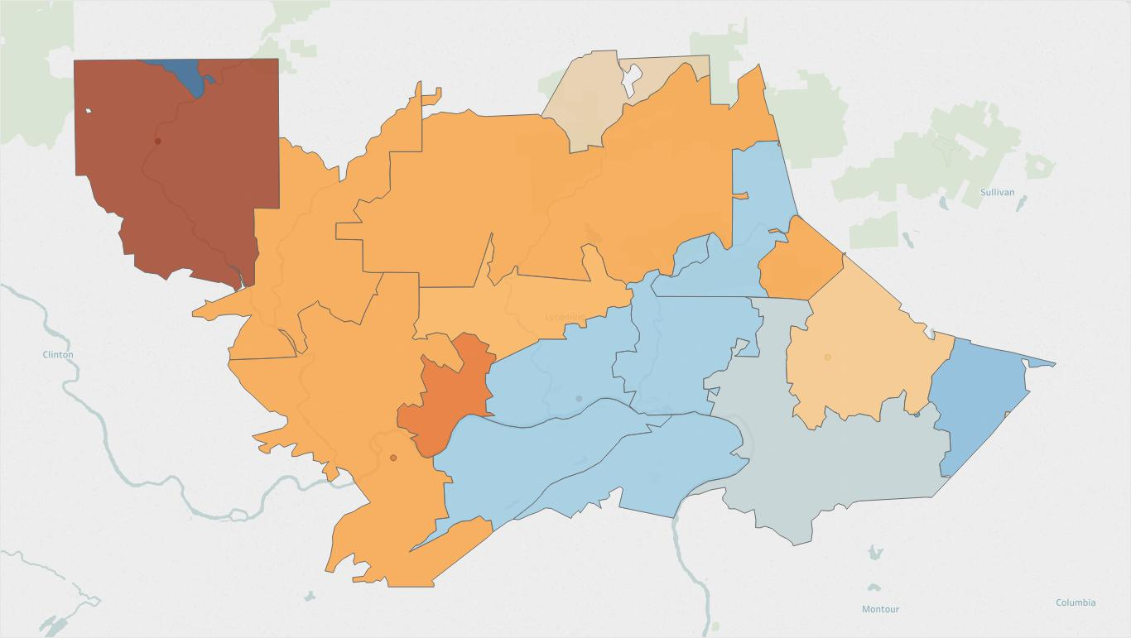
Data Examples
PDMP Data
How do we use this information?
Total Days Dispensed per Zip Code
Targeted education for prescribers, dispensers, and residents in areas of high dispensing.
Increase number of prescription drug drop off boxes for residents.
Increase access to naloxone in areas of high dispensing.
Target drug take-back events in these areas.
Median Days Supply Dispensed per Zip Code

Slide 7
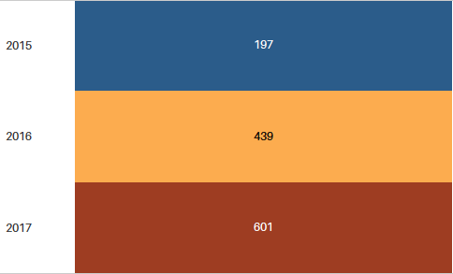
Data Examples
911 Call Data
Overdose Related Call by Year
What might this tell us?
More individuals are calling 911.
Overdoses are more often being reported.
There are factors that have contributed to the increase in overdose calls.

Slide 8
Data Examples
Emergency Department Data
Time Between Admission and Discharge
What decisions may this data inform?
Patients may be in the ED long enough to speak to someone about drug and alcohol treatment.
An on-call warm hand-off may be effective in this hospital.
Patients that leave AMA or leave after a short period of time present a missed opportunity for engagement.
Would an embedded warm hand-off be a potential solution for reaching that population?

Slide 9
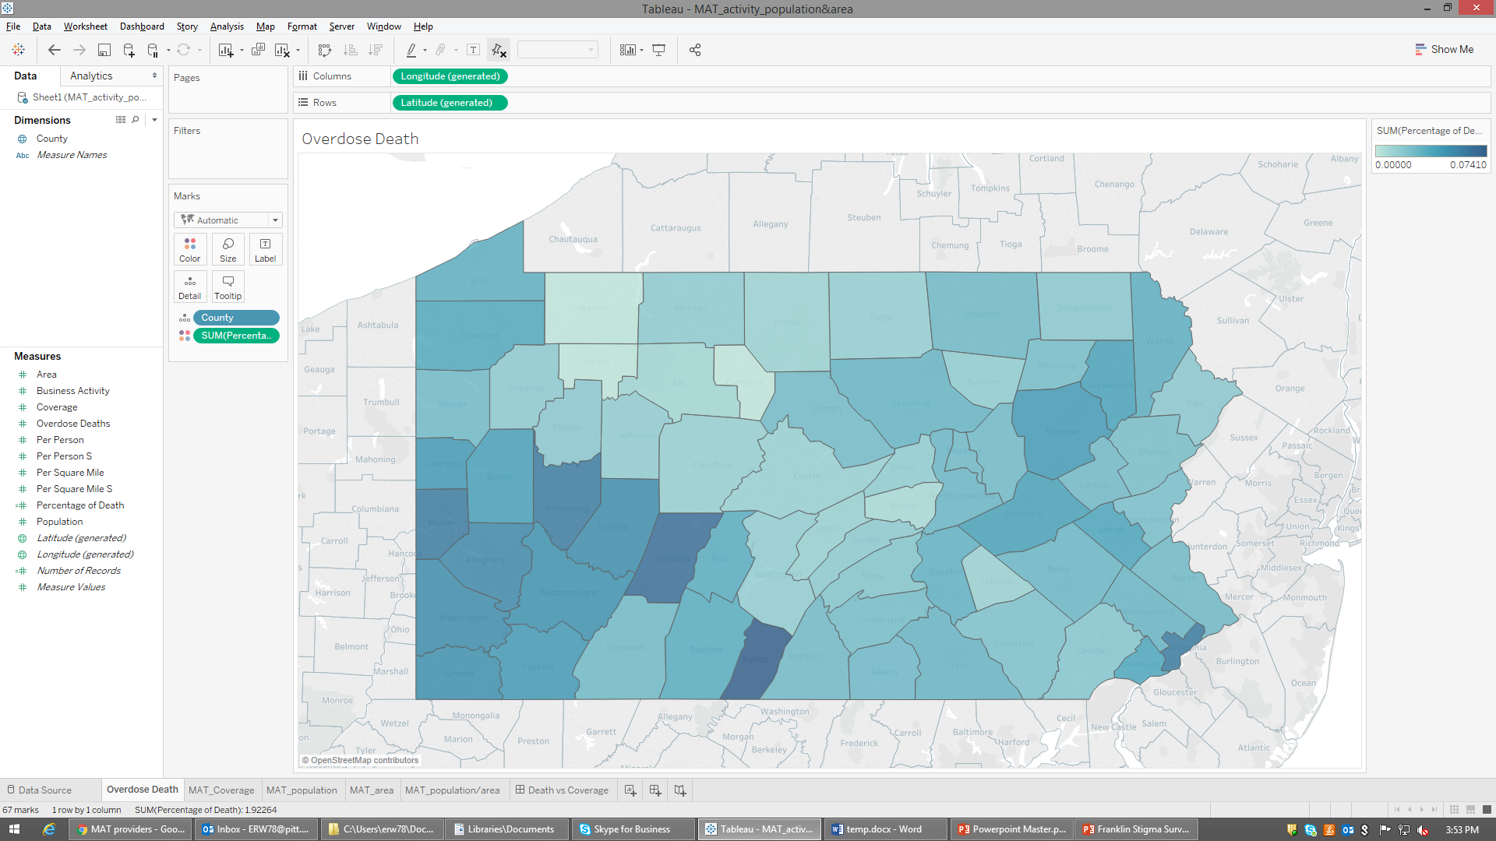
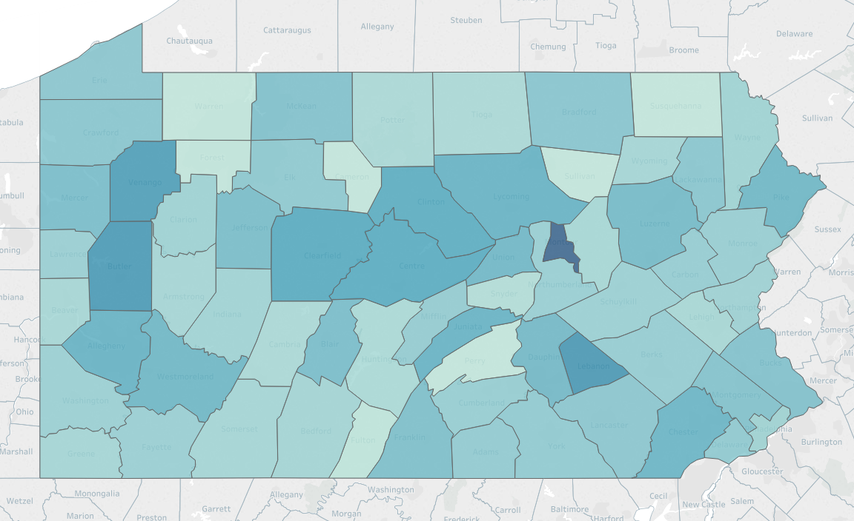
Data Examples
Medication Assisted Treatment (MAT) Provider Data
Overdose Death Rate
MAT Coverage
What does this tell us?
Number of MAT providers does not correlate with population
Counties with high overdose rates do not have sufficient MAT coverage
Efforts to increase access to MAT should be targeted in counties with high death rates and low MAT coverage

